Slide 1
TRAINING METHOD

Slide 2
TRAINING METHOD:
Circuit Training Method
Interval Training Method
Repetition Training Method
Fartlek Training Method
Weight Training Method

Slide 3
1. Circuit Training Method
Circuit training method was developed by R.E. Morgan and G.D. Adamson in 1953 at the University of Leeds, England. This type of conditioning involves almost all of the training factors. Circuit training can be designed to develop strength, power, muscular, endurance, speed, agility, neuromuscular co-ordination, flexibility and cardiovascular endurance. Circuit training typically involves a series of different exercises that you perform sequentially and continuously for one or more rounds. That is, you select several specific exercises and move quickly from station to station to maximize both training effectiveness and time-efficiency.

Slide 4
Muscular strength is developed through high-effort anaerobic activity, which fatigues the target muscle groups within 90 seconds of resistance exercise. In the past, people typically performed three sets of each strength exercise, resting two to three minutes between successive sets for sufficient muscle recovery. Of course, this resulted in relatively long training sessions , with much more time spent resting than exercising. To reduce the workout duration, with a minimum percentage of resting time and maximum percentage of activity time, circuit training involves one set of an exercise followed as quickly as possible by one set of another exercise for a different muscle group.

Slide 5
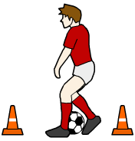
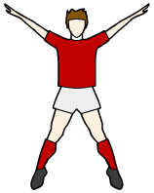
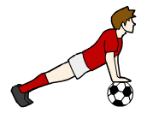
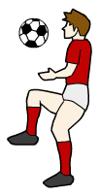
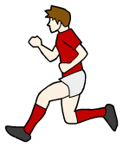
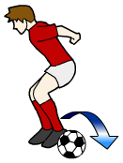
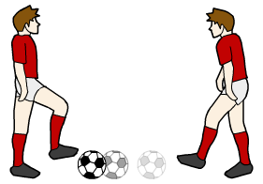
Here is an example of a circuit designed for footballers.
star jumps
dribbling
press-ups
2 MINUTE STATIONS
sit-ups
keepy-uppy
passing
sprints
sideways jumps

Slide 6
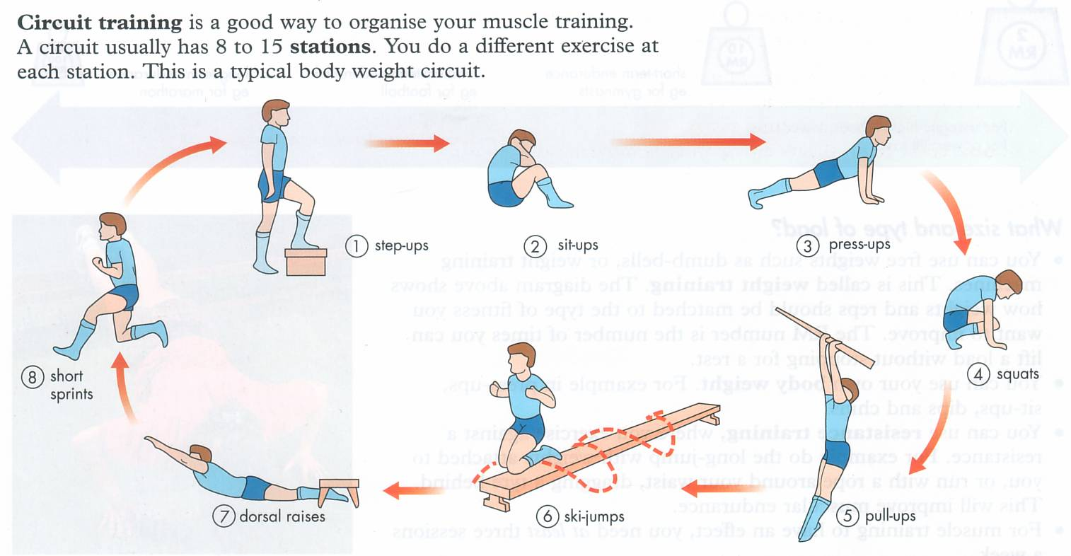

Slide 7
Disadvantages of circuit training
It can be very time consuming to set up and organize
People can get in each others way if the circuit is busy and performed in a small area

Slide 8
Advantages of circuit training
It is less boring due to all of the exercises being different
It is easily adaptable and can be set up in both indoors and outdoors
It is physically beneficial because you are improving your anaerobic and aerobic fitness
You can target specific muscle groups.
You can include weight training activities to increase strength.
You can increase the length of each activity to train the aerobic system.
You can include skill-based activities.

Slide 9
2. Interval Training Method
Interval training involves times of work followed by times of slower work or rest.
It is an exercise strategy that is intended to improve performance with short training sessions. The term can refer to any cardiovascular workout.
This involves periods of work followed by periods of rest.
The work interval may be a distance to run, say 60m, or a time to run, say 10 secs.
The rest interval may be a walk back to the starting mark, or simply not working (rest).

Slide 10
INTERVAL TRAINING is particularly suitable for team game players, as it consists of short bursts followed by slow walking or stopping.
It includes repeated sprint running or swimming, which is ANAEROBIC.
It takes place over short periods or bursts
It includes a rest period which allows for recovery
It includes repetitions of high quality, which raises the pulse into the TRAINING ZONE.

Slide 11
This training method is popular with performers who have to cover specific distances e.g. cyclists, rowers, swimmers- it allows them to work under or over their distances to set personal targets in terms of time. Interval training us to train for longer periods of time and can be used to develop both anaerobic and aerobic fitness depending on how we organize our training sessions

Slide 12
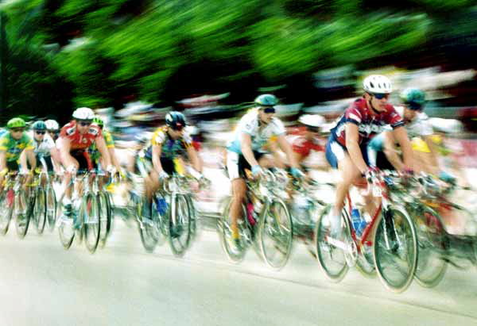
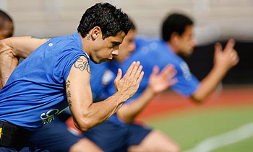
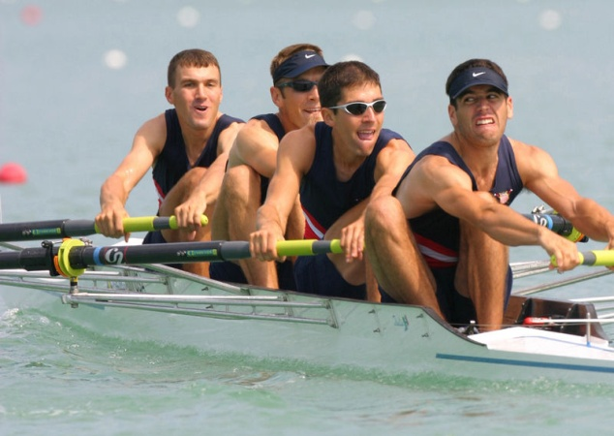
Cycling
Running
Rowing

Slide 13
Advantages & Disadvantages
Advantages:
It is physically beneficial because you are mixing both aerobic and anaerobic exercise together
Good method to set personal targets and goals to enhance fitness, performance and motivation
Disadvantages:
It can be repetitive and dull if new targets are not set
It can be disheartening if the performer cannot reach the required goal. Must ensure that the targets set are achievable to the individual

Slide 14
3. Repetition Training Method:
Repetition method regards as exercises which corresponds in parts to the requirements of competition being repeatedly performed during the training session. The intensity characteristics depends on the actual level of performance or aims and objectives of the training year. Breaks should be provided for complete recovery as possible.

Slide 15
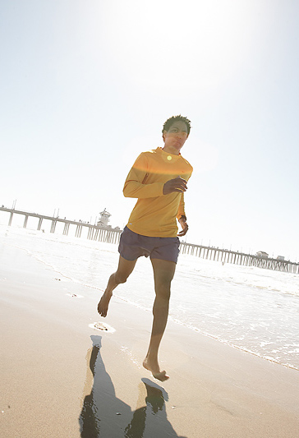
Continuous training
Continuous training is the simplest form of training. As the name suggests, it involves training with no rest periods or recovery intervals. This type of training is a good way to improve your aerobic energy system. Swimming, running and cycling are common examples of continuous training activities. You need to work for a minimum of 20 minutes to achieve some kind of benefit. The more fit you become, the longer you will be able to work for.

Slide 16
As fitness improves, you will also be able to sustain a higher level of intensity. You should start training at about 60% of your maximum heart rate (MHR) increasing to around 75%–80% as your level of fitness improves.
Continuous training depletes your carbohydrate stores. As the body needs an energy supply to keep working, it is forced into using fat supplies. This means that continuous training is a good way to burn fat and lose weight. Continuous training doesn’t just mean running. Aerobics is a popular form of continuous training. It is usually performed to music and requires the performer to coordinate whole body movements.

Slide 17
4. Fartlek Training Method
Fartlek training was developed in Sweden. It usually involves running, though you could apply the same principles to other activities like cycling and swimming. Fartlek is derived from the Swedish term meaning ‘speed play’. Essentially, this training involves many changes of speed. Intensity can also be varied, e.g., by running uphill or downhill. Like interval training, Fartlek training is good for performers in activities requiring changes of pace and sudden bursts.

Slide 18
Advantages
Fartlek training can be used to improve both the aerobic and anaerobic systems by mixing moderate activity with bursts of speed.
It can be varied to suit the fitness level of each individual performer and the available time they have to train.
This type of training can be used to avoid boredom in sports like running and cycling which can be monotonous.

Slide 19
Disadvantages
As the performer decides on the intensity of work, it can be hard for coaches to tell if performers are working as hard as they should be.

Slide 20
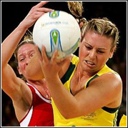
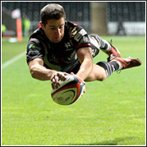
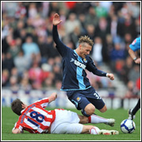
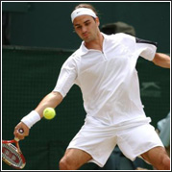
All of these performances could be improved from
fartlek training.

Slide 21
5.Weight Training Method
WEIGHT TRAINING is a form of training that is most commonly used to improve strength and muscular endurance.
It requires a resistance, usually in the form of a dumb bell, barbells or modern weight training (resistance) machines.
Weight training makes use of the progression principle of training by gradually increasing the amount of weight handled.

Slide 22
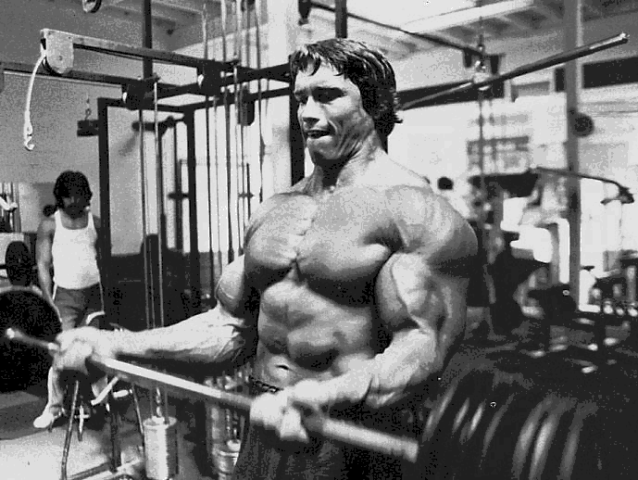
Weight training is an effective way of improving a performer’s strength.
Weight training is usually anaerobic. However, aerobic weight training can be achieved by using very light weights over a long training time.
Weight training is useful in several different ways:
It can improve muscular strength.
It can improve muscular endurance.
It can improve speed.
It can aid rehabilitation after an injury.

Slide 23
Ten Golden Rules of Weight Training Method:
Concentrate on the muscles while exercising.
Maintain a good rhythm during exercise.
Knees and elbows should be soft during most exercises. Knee and elbow joint should not be fully extended.
4. Inhale during positive stroke, exhale during negative stroke.
5. Always begin with smaller/light weight.
6. Start with larger muscles. E.g. bench press before curls.

Slide 24
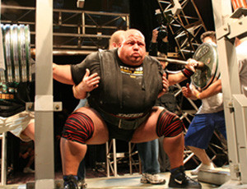
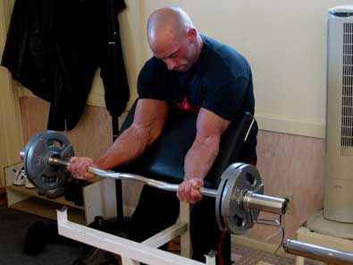
7. Rest between sets for 30-60 sec and then begin the new set.
8. Rest for 48 hours between workout for muscles recovery.
9. Take professional help to chalk out your programme, learn correct technique.
10. Warm up and stretch before workout and cool down after weight training.

